Slide 1
Cloud AI Services in Software Architecture

Slide 2
Service integration
Cloud AI services in larger software architecture landscape

Slide 3
Software architecture
Fundamental structure of a software system

Slide 4
Clean architecture
By Robert C. Martin (Uncle Bob)
Infrastructure
Domain

Slide 5
Hexagonal architecture
Adapters
UI
Email adapter
Application
(core)
Test script adapter
Business events
Notification
SMS
adapter
Logging adapter
Administration
DB adapter
Persistence
Admin CLI
File adapter

Slide 6
Integration patterns

Slide 7
Loosely integrated, asynchronous, batch
No direct communication between the cloud AI service and the rest of the system
Can have intermediary component, e.g. data storage
Example: batch processing (translation, captioning, anomaly detection)
My System
Cloud AI Service
Data storage

Slide 8
Synchronous call 1/3
Direct synchronous communication from my system to the cloud AI service
Communication pattern: REST
My System
Cloud AI Service
Data storage

Slide 9
Synchronous call 2/3
Potential problem: changes in REST API
  decommissioning old services
  compatibility-breaking version updates
Potential solution: anti-corruption layer
MyService
TranslationService
(legacy) REST /v1/translate
(legacy) TranslateV1
(current) TranslateV2
REST /v2/translate

Slide 10
Synchronous call 3/3
Potential problem: service unavailability or limited availability
  No response (timeout)
  Response with error message
  Correct response but with long delay
Potential solutions
  Circuit-breaker pattern
  Observability
  Queueing / retries

Slide 11
Webhook pattern 1/3
Direct synchronous communication from an cloud AI service to my system
Communication pattern: REST via HTTP
Example
  notification after completing batch job
  call to our system to fetch additional data (e.g. to display your account details in a chatbot conversation)
My System
Cloud AI Service

Slide 12
Webhook pattern 2/3
Potential problem
  Unavailability or limited availability of our system
Potential solutions
  HA (high availability) practices
  Monitoring and observability

Slide 13
Webhook pattern 3/3
Potential problem
  Exploiting AI cloud service to access data from our system
  Sensitive data can "travel" from our system via cloud provider to the user (and vice-versa)
Potential solutions
  Authentication and authorization
  Security audits

Slide 14
Synchronous calls vs webhooks
Can be mixed
  One system is not limited to use only one integration pattern
Synchronous calls
  Our system is upstream and the Cloud AI Service is downstream
Webhooks
  AI Cloud Service is upstream and our system is downstream
upstream
My System
downstream
depends on
depends on

Slide 15
Continuous Integration & Deployment

Slide 16
Cloud AI Services & CI
Cloud AI Services treated as resources
  Text-based representation, e.g. Terraform, Cloud Formation (AWS), REST calls
  Stored in GIT as any other text-based asset
Automated deployment and testing
  Using "environments" - e.g. dev, test, prod
How it affects deployment "units"?
Scripted language files
Compiled executables
Configuration files
Static assets
Database migration script
Cloud AI Service assets (???)

Slide 17
Service composition

Slide 18
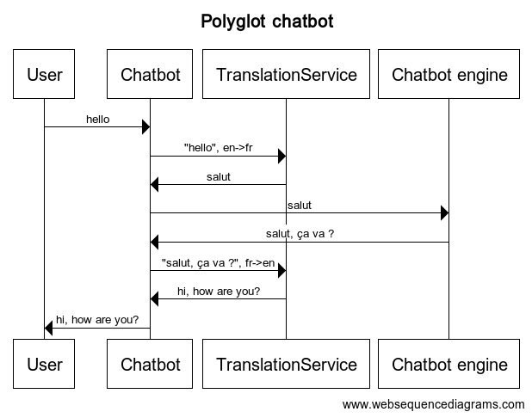
AI service composition – Polyglot chatbot
Notes:
title Polyglot chatbot
User->Chatbot: "hello"
Chatbot->TranslationService: "hello", en->fr
TranslationService->Chatbot: "salut"
Chatbot->Chatbot engine: "salut"
Chatbot engine->Chatbot: "salut, ça va ?"
Chatbot->TranslationService: "salut, ça va ?", fr->en
TranslationService->Chatbot: "hi, how are you?"
Chatbot->User: "hi, how are you?"

Slide 19
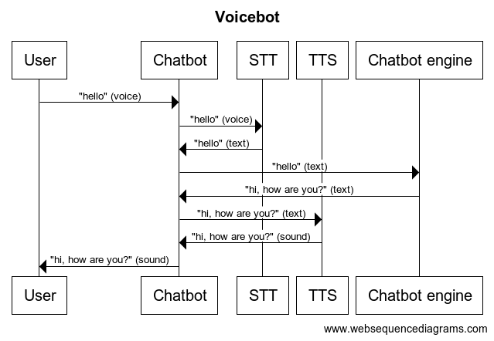
AI service composition – Voicebot
Notes:
title Voicebot
participant User
participant Chatbot
participant STT
participant TTS
User->Chatbot: "hello" (voice)
Chatbot->STT: "hello" (voice)
STT->Chatbot: "hello" (text)
Chatbot->Chatbot engine: "hello" (text)
Chatbot engine->Chatbot: "hi, how are you?" (text)
Chatbot->TTS: "hi, how are you?" (text)
TTS->Chatbot: "hi, how are you?" (sound)
Chatbot->User: "hi, how are you?" (sound)

Slide 20
AI service composition –
Chatbot "receptionist" 1/4
HR Chatbot
Chatbot "receptionist"
(router)
User
Internal IT Chatbot
Procurement chatbot

Slide 21
AI service composition –
Chatbot "receptionist" 2/4
Option 1 - "router" detects entry intents and redirects to target chatbot
  Problem: changes in downstream chatbots requires changes in "router"
  Problem: "router" is quite complex with duplicated intents

Slide 22
AI service composition –
Chatbot "receptionist" 3/4
Option 2 - "router" has no "knowledge", it forwards the call to ALL target chatbots at once and redirects the conversation to this one with highest confidence in response
  Problem: every call is charged N+1 times (expensive!)
  Problem: higher latency – waiting for responses

Slide 23
AI service composition –
Chatbot "receptionist" 4/4
Option 3 - "router" has no "knowledge", it forwards the call to target chatbots ONE BY ONE and redirects the conversation to this one with confidence at acceptable level
Improvements comparing to previous Option 2
  Expected number of calls is <N+1
Problem: every call is still charged more than once
Problem: more variable latency
  can be lower comparing to Option 2 if we match fast or higher if we match late
Problem: more complex setup
  We have to decide in which order to call the target chatbots

Slide 24
AI service composition
Image recognition filter
User input (image)
Get input image
Dispatcher
Proper image processing
Specialized image recognition model
Preliminary image check
General purpose image recognition

Slide 25
Service composition – summary
Advantages
  More functionality
Disadvantages
  Higher costs
  Higher latency
  Higher risk of failure

Slide 26
Testing
Testing strategies of cloud AI services

Slide 27
Testing AI services
Prepare data sets
Training data set
  Chatbot: learning phrases
Testing data set
  Chatbot: test scenario
In some cases we might need also validation data set

Slide 28
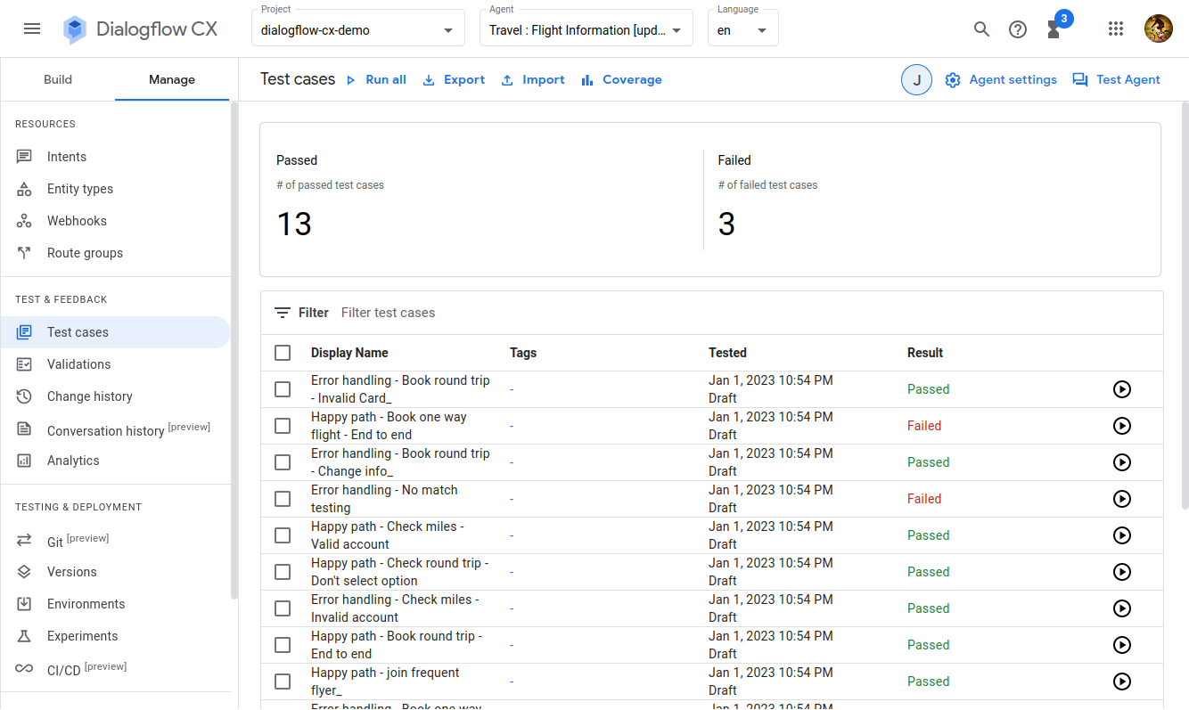

Slide 29
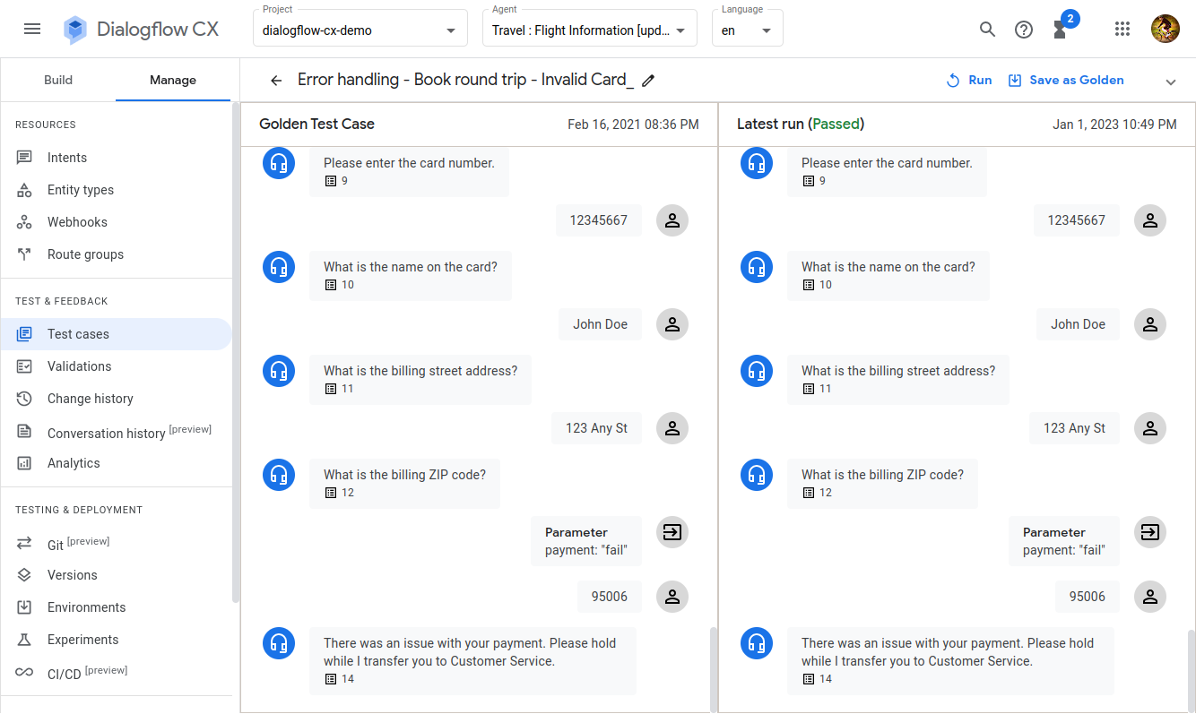

Slide 30
Botium
"Selenium" for chatbots
https://www.botium.ai/
Supports all major chatbot services
  Dialogflow CX & ES, IBM Watson Assistant, Amazon Lex, Microsoft Azure Bot Service and other
SaaS and on-premise (only for Enterprise plan)
Individual pricing
Free option available (with limited functionality)
Enterprise plan also contains security and performance testing capabilities
Notes:
https://support.botium.ai/hc/en-us/articles/4973816377871-Botium-Connectors
https://botium-docs.readthedocs.io/en/latest/03_testing/01_testing_conversational_ai.html

Slide 31
Conclusions
Cloud AI Services but be wisely integrated with existing systems and processes

Slide 32

Q&A

